Slide 1
3SAT- A Semi-Supervised Learning approach to Sentiment Analysis and Classification of Tweets
Arpit Sharma
Sarah Riaz

Slide 2
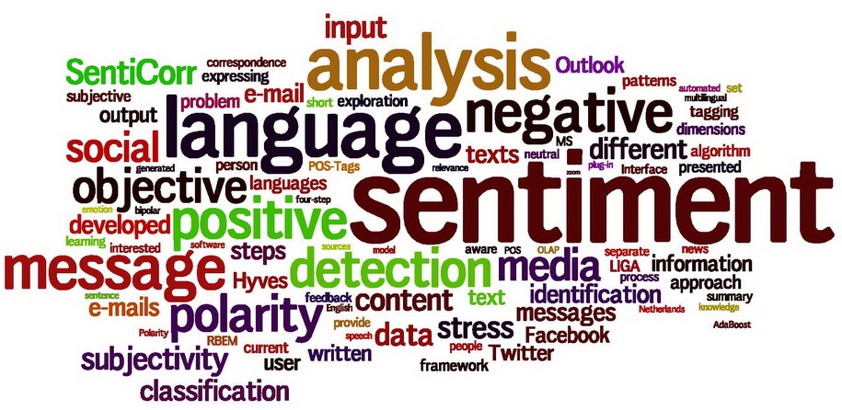

Slide 3

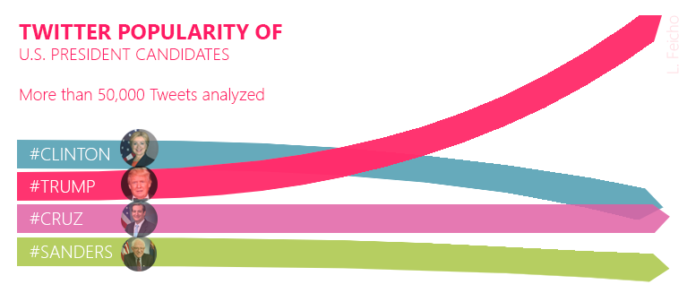
Sentiment Analysis Applications
Business
Politics

Slide 4
Business
Better Targeted Marketing
Faster Detection of Opportunities and Threats
Brand Reputation Protection
Profit

Slide 5
Politics
Popularity of Political Figures
Popularity of Policies/Governmental Decisions
Hate Speech

Slide 6
Sentiment Analysis Categories
Positive
Negative
Neutral

Slide 7
Sentiment Analysis Tasks
Opinion Mining
Opinion Extraction
Sentiment Mining
Subjectivity Analysis
Customer Complaint
Affect Analysis
Emotion Analysis
Review Mining
Review Analysis

Slide 8
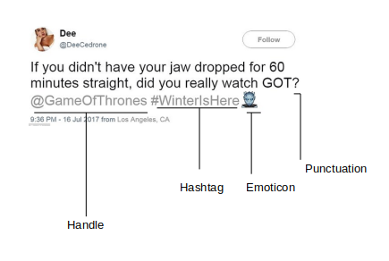
Breakdown of a Tweet

Slide 9
Breakdown of a Tweet
A hashtag is a word or an un-spaced phrase prefixed with the hash symbol (#). These are used to both naming subjects and phrases that are currently in trending topics. For example, #iPad, #news
Every Twitter user has a unique username. Any thing directed towards that user can be indicated be writing their username preceded by ‘@’. Thus, these are like proper nouns. For example, @Apple
Although not all Punctuations are important from the point of view of classification but some of these, like question mark, exclamation mark can also provide information about the sentiments of the text. We replace every word boundary by a list of relevant punctuations present at that point.
Use of emoticons is very prevalent throughout the web, more so on micro- blogging sites. We identify the following emoticons and replace them with a single word.
People often use repeating characters while using colloquial language, like "I’m in a hurrryyyyy", "We won, yaaayyyyy!" As our final pre-processing step, we replace characters repeating more than twice as two characters.

Slide 10
Processing a Tweet
Punctuations
Possible
Words/Expression
Emoticons
Replace with
Label values
Hashtags
Look-up the word
Post ‘#’ in the
Dictionary
Redundant Word
Replace with
Redundant letter with
one occurrence

Slide 11
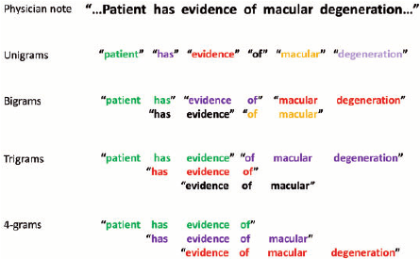
n-Grams

Slide 12
Process Flow
Preprocessing
Vectorization of Features
Scaling and Normalization
Assigning Class Weights
Model Selection
Predictions

Slide 13
Preprocessing
Replace Links with ‘url’
Replace @[handle] with ‘@user’
Replacing Slangs with Proper Words
Remove Stop Words
Negating Words
POS Tagging
Word Frequency

Slide 14
Features
Afinn Score 96
Afinn Score 111
Lexicon Score
Senti 140 Score
NRC Score
Binliu Score
Sentiword Score
Writing Style
Emoticon Score
Unicode Emoticon Score
Unigram Score
Post Unigram Score

Slide 15
Process Flow
Preprocessing
Vectorization of Features
Scaling and Normalization
Assigning Class Weights
Model Selection
Predictions

Slide 16
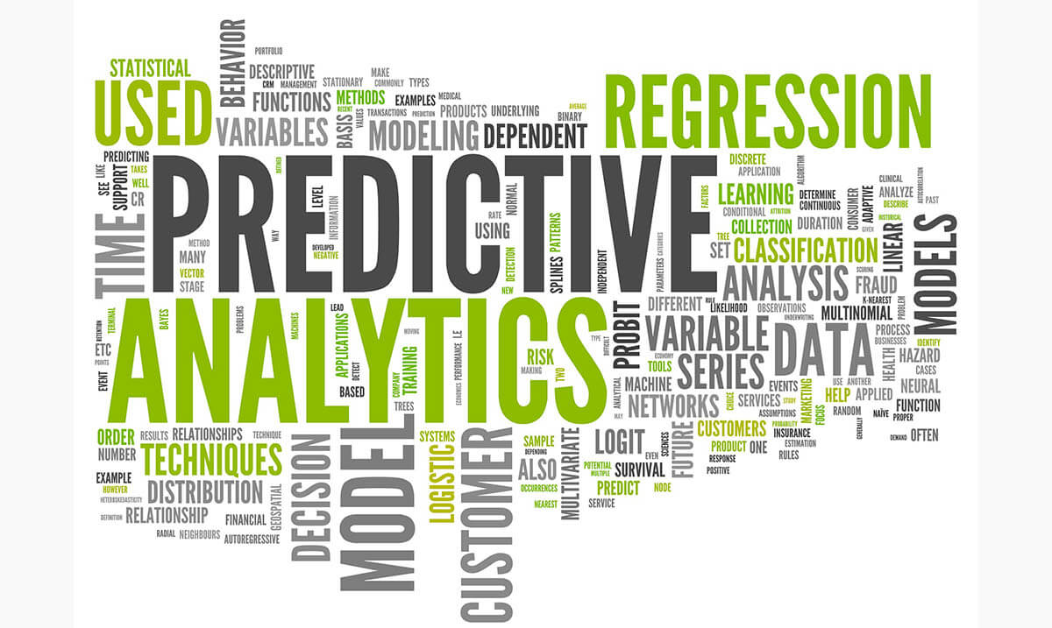

Slide 17
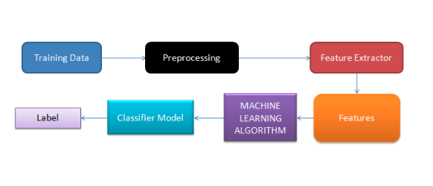
Supervised Learning

Slide 19

WHY BOTHER WITH SEMI-SUPERVISED LEARNING THEN ?

Slide 20


Slide 21
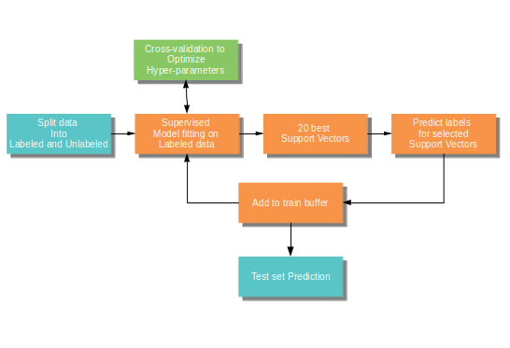
Flow of Semi-supervised Learning

Slide 22
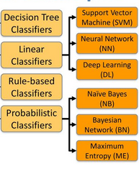
WHAT ARE THE OPTIONS ?

Slide 23
Models
SVM Linear kernel-L2 and L1
SVM Radial kernel-L2 and L1
Logistic Regression
Naive Bayes Classifier
Decision Tree Classifier
Stochastic Gradient Descent Classifier

Slide 24
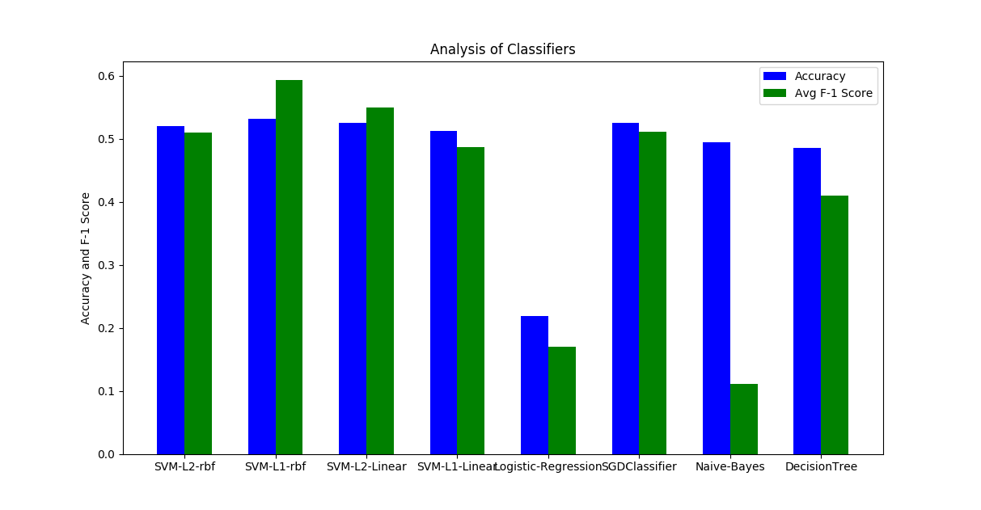
Model Comparison

Slide 25
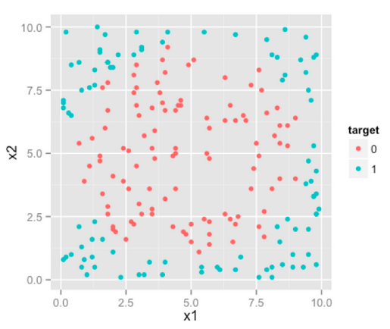
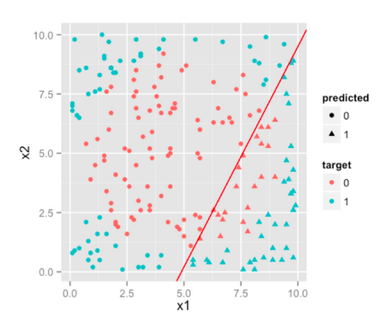
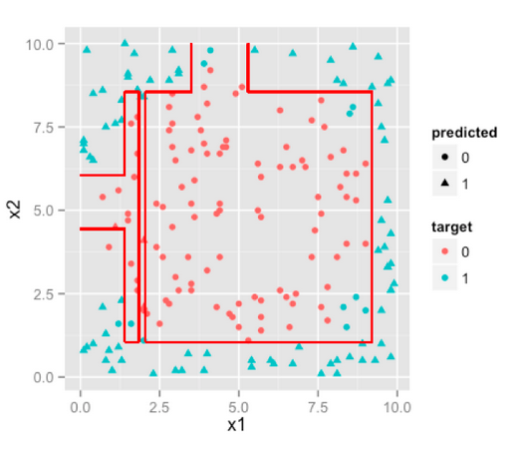
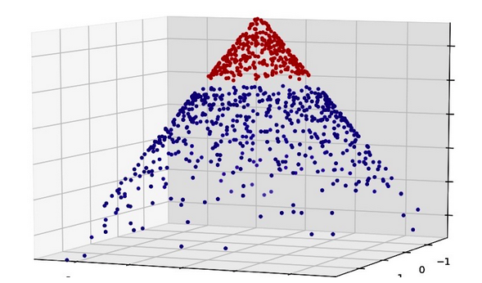
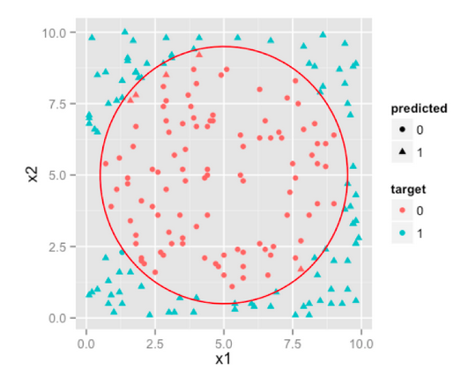
Why not Logistic Regression?
Sample data
Decision Trees
Logistic Regression
SVM with extrapolation
SVM in original feature space

Slide 26

Why not SGD or Decision Trees?

Slide 27
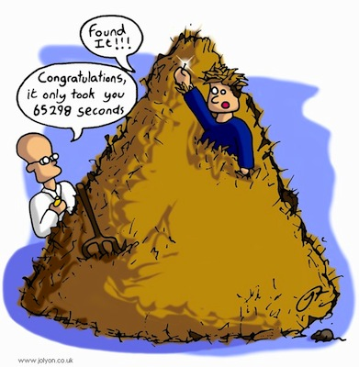
Why not SGD or Decision Trees?

Slide 28
The Process...again!
Cross-validation to
Optimize
Hyper-parameters
Split data
Into
Labeled and Unlabeled
Supervised
Model fitting on
Labeled data
20 best
Support Vectors
Predict labels
for selected
Support Vectors
Add to train buffer
Test set Prediction
HOW?

Slide 29
Our Experiments
Ideally we would like to have 100% data as labeled
But we have established that is neither cheap nor pragmatic
Instead we simulate a real-world scenario and try to split the data into labeled and unlabeled in a ratio so as to achieve maximum accuracy and also ensure realism
In order to determine that sweet spot, we ran some tests, with different ratios observed the results

Slide 30


Slide 31
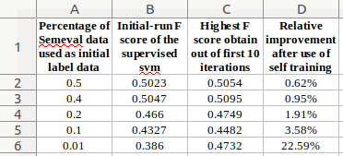
Improvement with Different Ratios

Slide 32
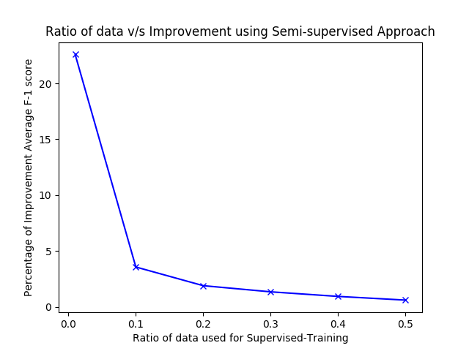

Slide 33


Slide 34
Summary
SVM with radial kernel and L-1 normalization works best for our data
Logistic Regression performs poorly
Naive Bayes performs decently yet is not robust as it has the worst F-1 Score among all
Although SGDClassifier and Decision Trees are comparable they take their sweet time to converge on a model

Slide 35
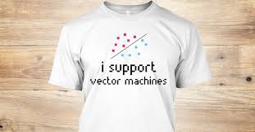

Slide 36



Slide 37
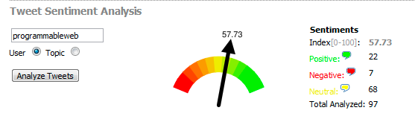
Individual Analysis based on Handle

Slide 38


